Slide 1

TEAM CLOUD CHRONICLES
MICROSOFT AZURE VIRTUAL HACKATHON 2020-21
Athira Krishnakumar Nair, Prashant Islur, Ravi Singh, Dhruv Sharma
Team From New Zealand

Slide 2
Problem statement
Small businesses and start-ups are important for fostering local economies, reducing unemployment, and generating vibrant and supportive community.
US Small Business Administration (SBA) supports small businesses and start ups through a loan guarantee program. This program supports banks to grant loans to small businesses by reducing the risk of the banks to lose loan money as SBA guarantees the portion of the loan if the business default on repayment.
As SBA guarantees only a portion of the loan, banks still incur losses and hence face difficulty in decision making to whether the loan should be approved or not.
Objective
There has been a lot of research and analysis on loan default situations but our main goal was to leverage the use of Microsoft Azure and AI platform and utilise our data science capabilities to build a predictive model that can identify high risk customers.
We will also create an end-to-end solution providing the customers and bankers an easy to use platform that is reliable and efficient. For that purpose, we will choose Power apps.
We will create a user interface for customers and bankers so that they can interact with the model and get relevant information to make decision.
Using this approach we are trying to minimise risk of the bank incurring losses from defaulted loans.
Explore the opportunities of integrating Microsoft Azure Cognitive Services to provide AI solutions to assist with loan document application, determine client’s affordability and predict credit risk.

Slide 3
team approach to build azure ML solution
Using Microsoft Azure PaaS capabilities along with Microsoft Power Platform combined with our team’s competency in building Machine Learning and Data Science solutions, we have built a working prototype of a Power App which predicts a customer defaulting on a loan using a growing historical US SBA open dataset available on Kaggle.
The Power App which primarily could be used by prospective lenders, venture capitalists and regulatory authorities to not only analyze industry trends but also by ‘similar’ and like to like customers to check on the likelihood of themselves availing a loan.
Although this prototype is not a complete solution, our team's focus is primarily to use Microsoft Azure infrastructure, Azure cognitive AI Services to make the solution more scalable and configurable to the evolving needs in the banking sector.
We plan to possibly grow the App with integrating fraud and anomaly detection services using AI capabilities of Azure.
Research on data that aligns with the problem statements.
Deployed the ML model and used Power Automate to connect to Power Apps to build an interactive platform
Finalised the raw data that best aligns with the bank problem due to Covid-19 situation
End to End Solution thought process
Used AutoML and Designer in Microsoft Azure to build the best ML models.
Studied each and every column of the data. Data Pre-processing was carried out.
Power BI to perform exploratory analysis and to choose the variables that will best support the prediction?

Slide 4







Data overview
1900 - 2014
Accounted for variation due to the Great Recession (December 2007 to June 2009)
50 US States
City
Zip Code
Gross Disbursement Amount
Charged off Principal Amount
SBA Gross Approval Amount
Balance Gross Amount
Whether the business is new or existing one?
Term of the loan
Whether the company has gone through LowDoc Program?
Whether the company lies in the revolving credit line?
No. of Job Created and Retained
No. of employees in the company
Whether business is a franchise or self-owned?
Charged off
Bank State
Bank Name
Loan Digit Number
20 different industries loan records
Paid in Full

Slide 5
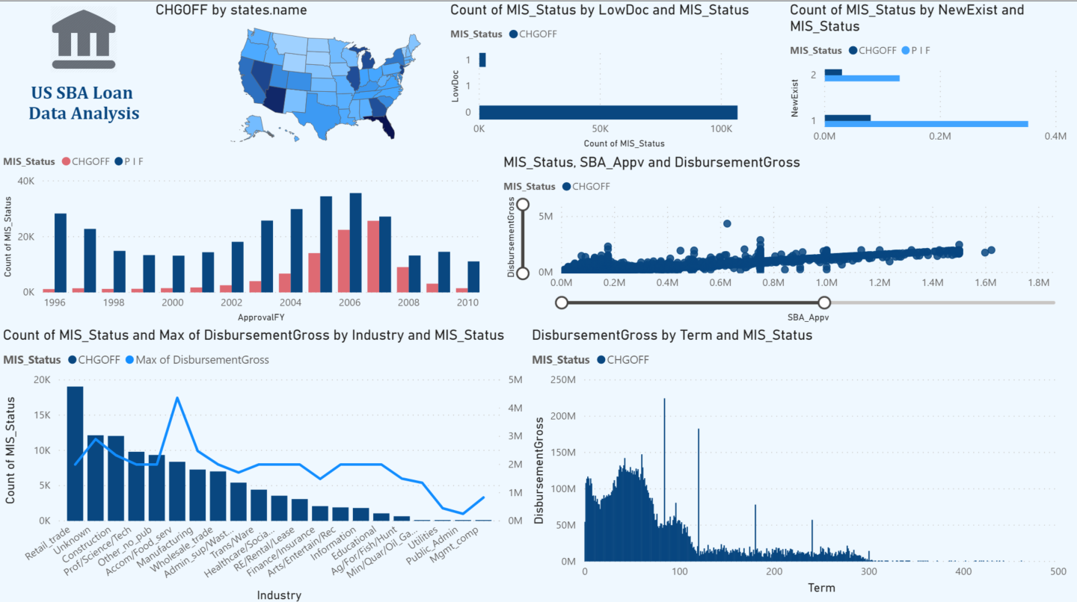
Exploratory Analysis using Power bi
1
2
3
Higher default rate has been observed in Florida, Georgia, Arizona, Nevada, Illinois, Michigan, and California.
Relatively low default rate has been observed if the customer has gone through Lowdoc program.
Comparatively high default rate has been observed if the loan has been approved for a new business. But at the same time high proportion of customers have repaid their loan who belongs to a new business. Thus, background of the business needs to be studied.
High default rate was evident due to Great Recession period (2007-2009).
A relatively positive correlation can be observed between the loan amount disbursed and SBA Approval amount. This tells us that higher the amount of loan, higher proportion of amount is guaranteed by SBA. Higher default rate has been observed where the SBA approved amount were less than or equal to 1.5M.
Higher default rate has been observed in Retail and Trade Industry followed by construction, Science and Tech industry.
High default rate has been observed when the business took loan for less than 100-150 months.
4
5
6
7

Slide 6
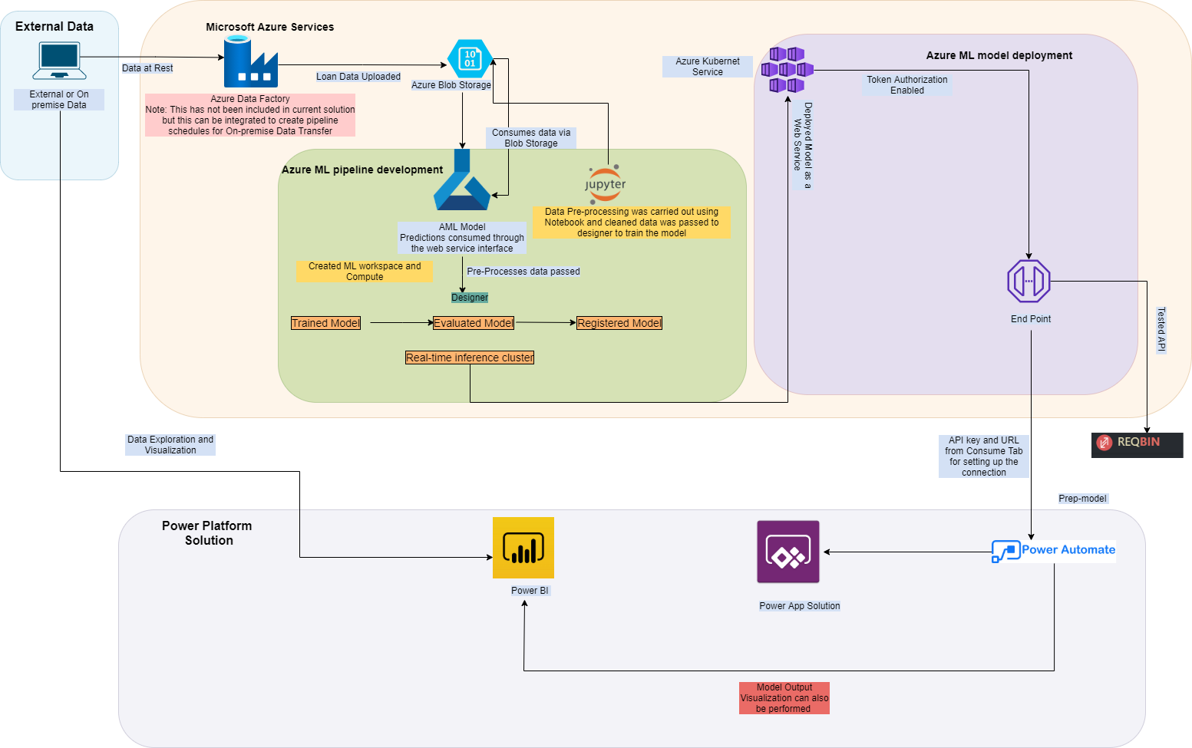
Our Microsoft Azure Architecture solution for loan prediction
The solution walks through the end-to-end process of how to develop predictive analytics using a set of simulated loan history data to predict loan charge off risk.
The solution template also includes a set of python scripts used to perform data pre-processing.
Exploratory analysis have been performed with pre-processed data using Power BI.
The solution also includes scripts to deploy the model as a webservice.
The model is consumed to Power Apps using Power Automate.

Slide 7
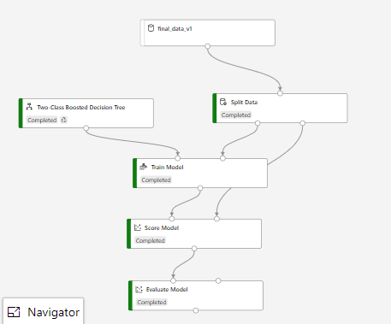
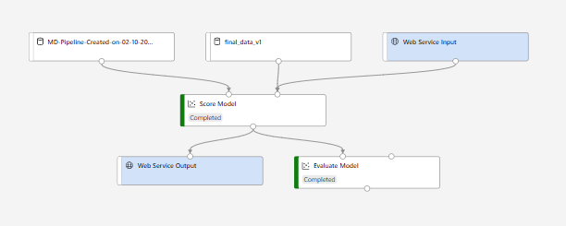
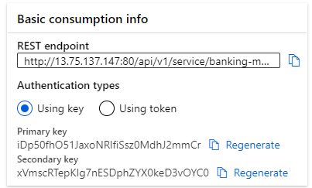
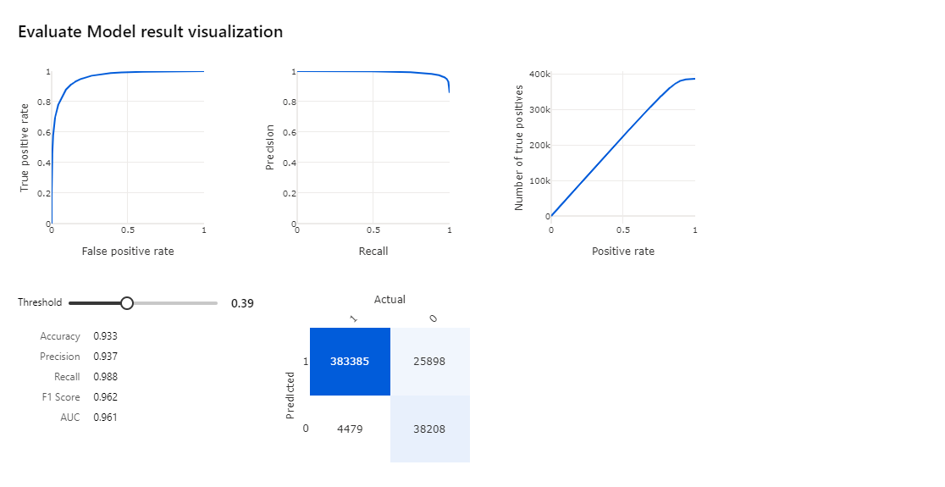
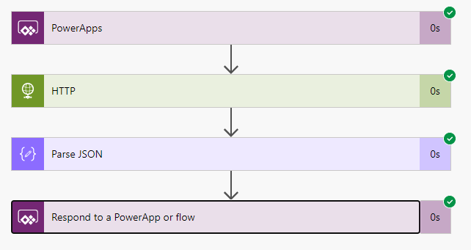
Designer Model Output
ML Model Pipeline
Deploying model as a web service
REST API Endpoint used to consume model
Data cleaning was carried out using notebook and cleaned data was passed to this ML pipeline
Model Output
Power Automate flow to connect ML model to Power Apps

Slide 8
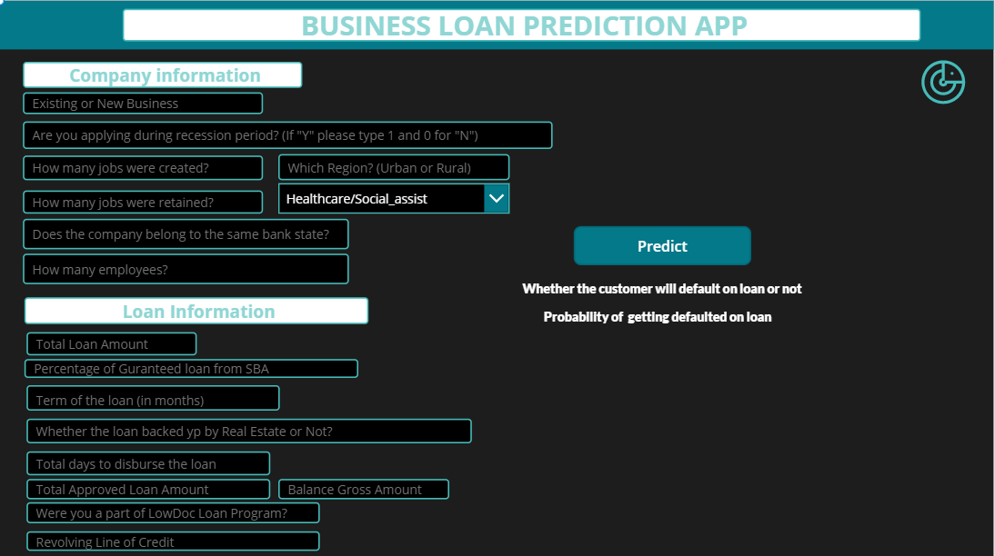
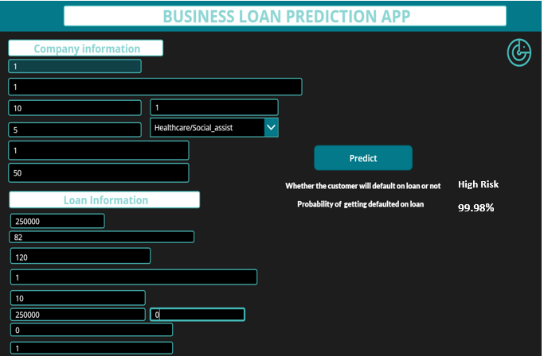
Power aPP solution
APP Structure
App Prediction

Slide 9
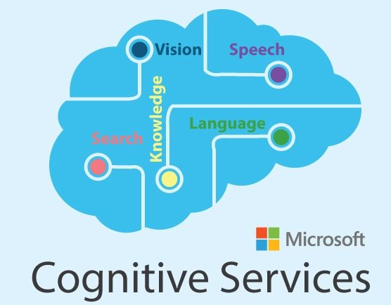








AI and ML Integration approach and potential market to use the solution
Solution Use Case
Leveraging the Azure platform for ML, AI and AA
Using Azure Cognitive services – Anomaly detector we can get early warning signals by identifying the potential entities that are exposes to high risk of default before even it occurs.
Using Azure Cognitive services – Microsoft Azure AI Text Analytics:
To analyze the textual data using Natural language processing to build translational apps or virtual assistant on smart phone that can help even the not so techno savvy people.
To capture the written media from social media posts to financial news that can be used as a potentially good parameters for stronger credit analysis.
Artificial Intelligence (AI) can widely touch on areas like fraud detection, model validation, stress testing, and credit scoring.
Some of the limitations to the model are as follows:
Most of the AI algorithms are considered as black box which can make the governance framework for these applications relatively immature.
To overcome the issue off poor governance framework we need relatively high-quality data to keep the AI running properly.
Financial Institutions, Regulators and Venture Capitalists
Determining industry credit worthiness
Detection of Fraud patterns
Anti-laundering Money
Financial lending to small business enterprise
Loan Banking providers
Streamlining the loan application process.
Identifying the riskier applicants
Lower operational cost
Customer Segmentation
Increase chances of cross selling
Help increase customer lifetime value
Model Development and Deployment
Consumers
Customers can fill in their own details:
To find out how likely they are to be offered a loan
To find out like to like customers
Personalise repayment schedule to increase the chance of future loan approvals.
ML Pipeline Orchestration and Storage

Slide 10

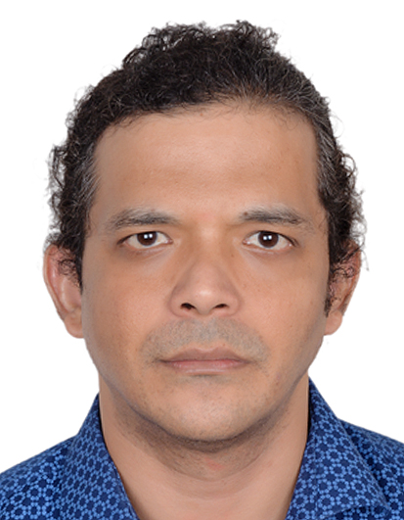


KNOW the Team Behind This
Ravi Kumar Singh
Information Analyst & Machine Learning Engineer
Pegasus Healthcare Limited, NZ
6+ Years in Analytics, Machine Learning, AI Experience
Masters of Applied Data Science - University of Canterbury, NZ
Chess, Football Enthusiast, Basketball
Dhruv Sharma
BI & Data Science Specialist
Farmlands Cooperative Society Limited NZ
Ex Deloitte | 8+ Years Analytics Experience
Masters of Applied Data Science - University of Canterbury, NZ
Post Grad Dip in Business Management - Symbiosis International University
Problem Solver, Cricket Enthusiast
Athira Krishnakumar Nair
Lead Data Scientist at Pyper Vision | Microsoft Data Analyst Associate Certified | SAS Predictive Modelling Certified
Leads NZ Data Science and Machine Learning community with 60+ data scientist across industries.
Masters of Applied Data Science from University of Canterbury, New Zealand
Masters in Statistics from Narsee Monjee Institute of Management Studies
Chess Player, Dancer, and Painter
Prashant Islur
Data Analytics & Cloud Specialist
15+ Years IT managed services Experience
Masters of Applied Data Science - University of Canterbury, NZ
Masters in Project Management - Sikkim Manipal University
B.E in Electronics & Telecommunication , Mumbai University
Team Leader, Mentor, Travel Enthusiast

